Slide 1
Home Décor Store: Week 2 Review
Team 3 · Software Development Life Cycle · November 2026
TRY THE WORKING APP
https://sdlc-g3.onrender.com/
Contents: developer report · QA report · wireframes for Increments 1 and 2

Slide 2
Developer: admin sign-in works; editing is next
Omkumar Patel · Developer
COMPLETED
NEXT
CHECKS
Admin sign-in and sign-out; the server rejects wrong passwords and ends the session on sign-out
Shop restyled: living room illustration, category artwork, layout that adapts to small screens
Admin page matches the shop; options and stock display still connected to SQLite
README updated with setup steps and an admin demo walkthrough
Let admins edit products and stock
Checkout and payments still pending
5 of 5
automated API and database tests passed
Passed
PROCESS NOTE
Week 2 changes were pushed directly to main, as agreed with Nir.
Angular production build
Admin sign-in confirmed by hand on the developer's laptop. Independent QA was pending at report time.
Code: github.com/gitnharamati/SDLC_G3
Notes:
Source: Team_3_Week_2_Developer_Report.docx (Omkumar Patel, 0480176).

Slide 3
QA results: 26 of 31 test cases passed
Romit Tejani · QA · 6.5 hours
31
26
3
2
PROPOSAL COMPLETION CHECKS
Check | Status this week
Required features work | Not complete. Sign-in and stock display built; editing, search, cart and checkout not yet built.
Totals and stock correct | Stock checked in the database (35 / 20 / 11) and cannot go below zero. Order totals untestable until checkout exists.
Admin access protected | API and browser checks pass. BUG-03 (global lockout) needs a fix.
test cases written
passed
failed
observations
Automated run (npm test): 28 tests, 24 pass, 0 fail, 4 marked "todo" for the known bugs. Production build succeeded.
PASSED
Guest, forged and malformed cookies rejected; 30-minute expiry; 429 after 5 failures
Sign-out ends the session; public catalogue exposes no admin data
All 13 manual browser tests, incl. mobile widths, keyboard use, second browser
Lowest theme text contrast 5.1:1
DEVELOPER CLAIMS
Confirmed: five automated tests pass, the build passes, and the browser checks the developer asked for (sign-in, sign-out, wrong password, View options and stock) pass.
Notes:
Source: qa-Week-2.pdf (Romit Tejani, 0476882), report dated 8 November 2026. Test environment: Windows laptop, Node 24, Angular dev server, SQLite sample data (3 products, 14 option combinations).

Slide 4
QA issues: fix BUG-01 and BUG-03 first
Romit Tejani · QA
ID | Issue | Severity | Status
BUG-01 | Schema allows variants with no options, duplicate combinations, or options from another product | Medium | Open, still reproducible
BUG-02 | Unavailable products still shown (page ignores the flag) | Low now, higher once admins edit products | Open, still present
BUG-03 | Admin lockout counter is global: 5 failures from anyone block the real admin | Medium | New
BUG-04 | SQLite database file is tracked in Git; the ignore pattern misses apps/api/data/ | Low now, Medium once stock is editable | New
RISKS
BUG-01 affects the planned "last item, only one order succeeds" test
BUG-04 will cause merge conflicts once stock is editable
Editing depends on the admin session: settle OBS-09 and BUG-03 first
NEXT TASKS
OBSERVATIONS
Confirm BUG-02 in the browser and BUG-04 with git ls-files
Report BUG-01 to BUG-04 to Omkumar; retest after fixes
Write test cases for product and stock editing before it is built
OBS-05 Node version check in README · OBS-07 admin link visible to customers · OBS-08 week 2 pushed to main without review · OBS-09 admin page does not notice an expired session
Notes:
Source: qa-Week-2.pdf, sections 4 to 6. Full reproduction steps are in Bug_Log.md.

Slide 5
Home Décor Store Wireframes
8 screens · Increment 2 storefront (W-01 to W-06) and Increment 1 admin (W-07, W-08)

Slide 6
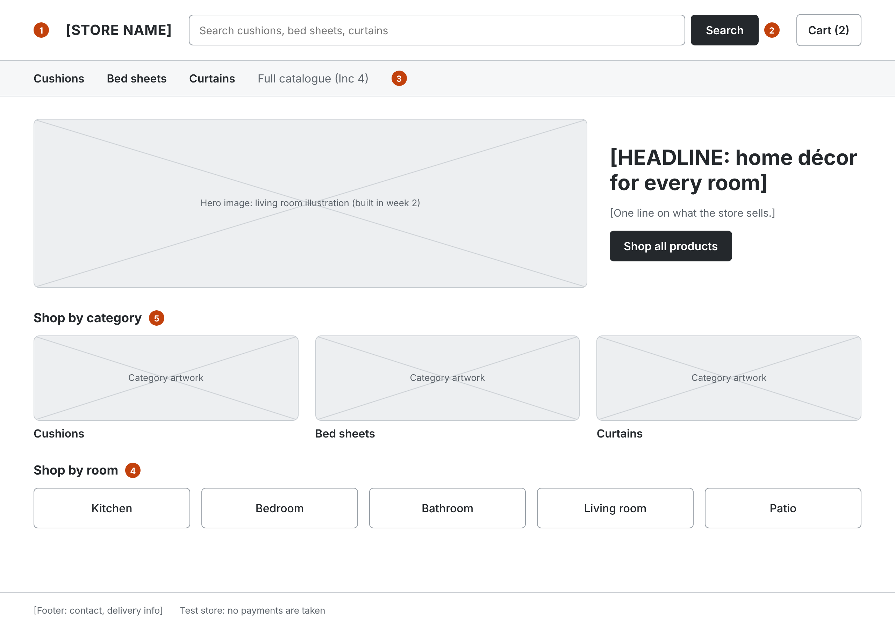
W-01 Home
Increment 2 · Storefront
Notes:
1 Header has no admin link (QA OBS-07). Admins use /admin directly.
2 Search by product name, any page (CUS-02).
3 Category nav: Cushions, Bed sheets, Curtains (CUS-01).
4 Shop by room: 5 rooms (CUS-06). Room + category is one click from results.
5 Any product within 3 clicks: category → product, or search → product (CUS-03).

Slide 7
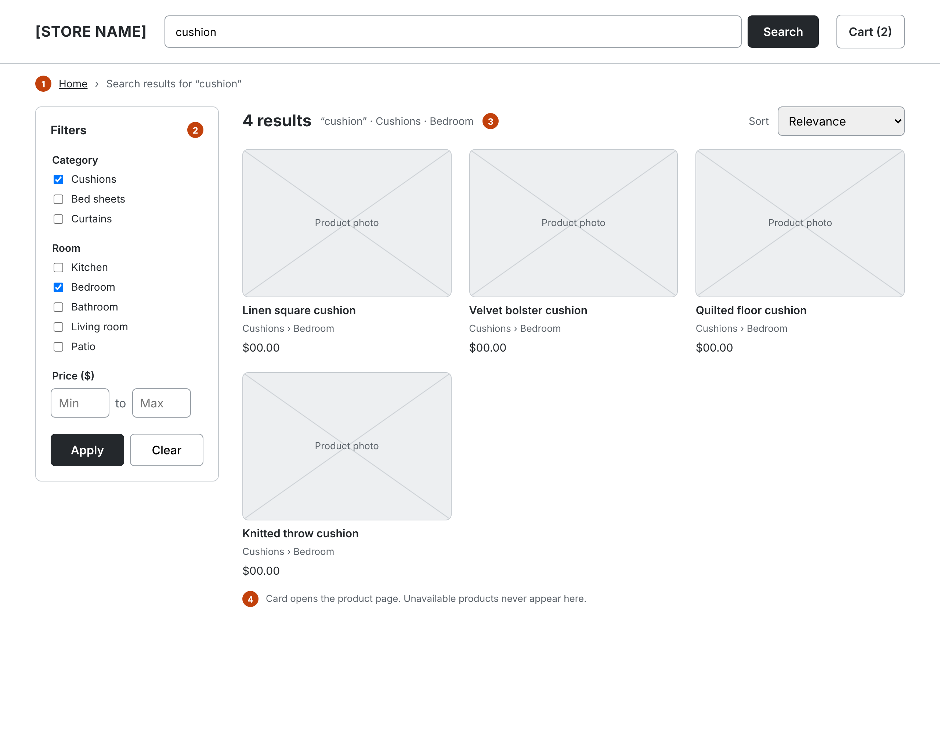
W-02 Search and category results
Increment 2 · Storefront
Notes:
1 Breadcrumb shows where the shopper is.
2 Filters: category, room, price min/max. Apply updates the list and the count (CUS-04, CUS-06).
3 Only available products are listed; the server filters, not the page (QA BUG-02, ADM-10).
4 Card shows photo, name, placement and price (one price per product). Card click opens W-04.

Slide 8
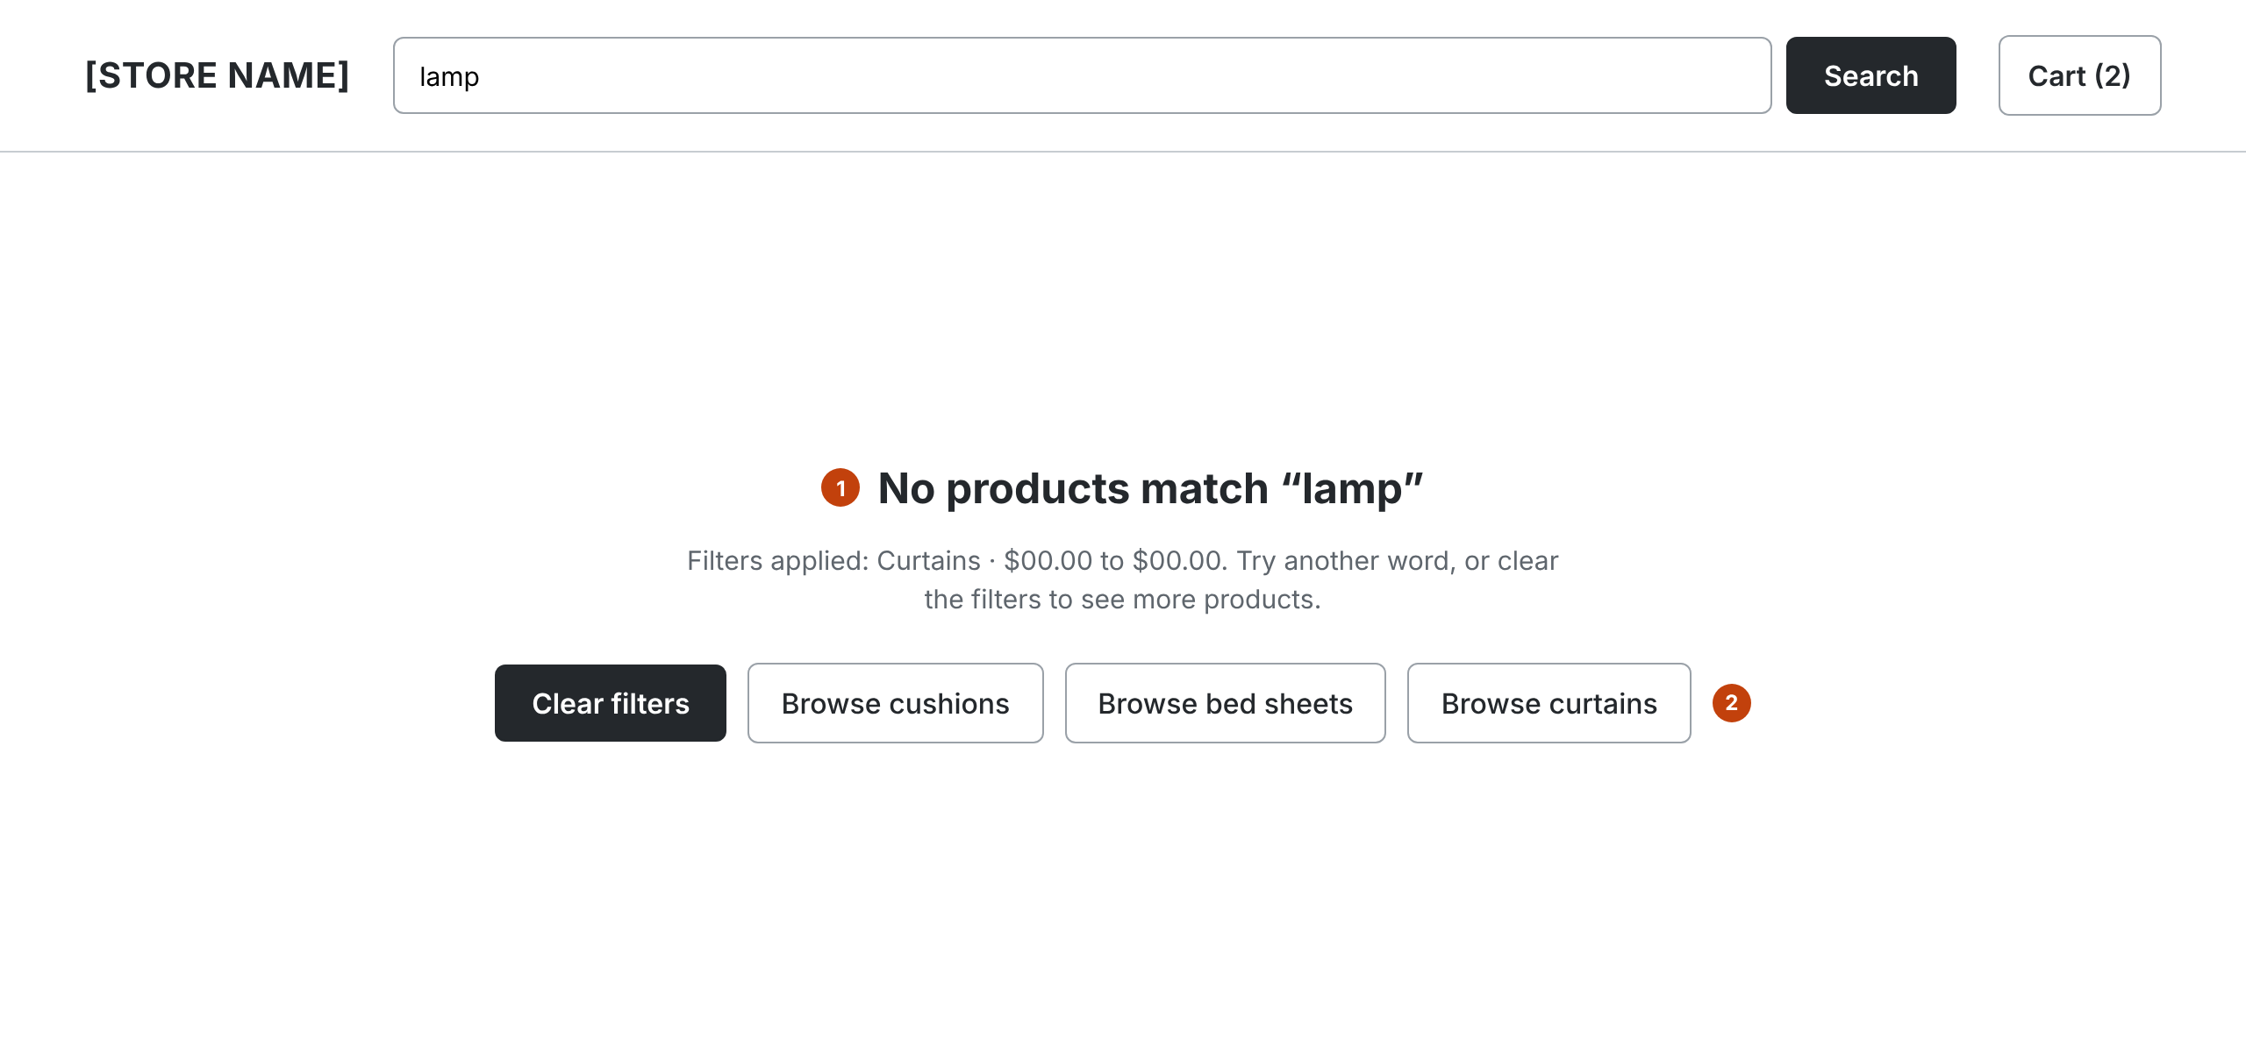
W-03 No results
Increment 2 · Storefront
Notes:
1 Plain message names the search term and active filters (CUS-05).
2 Two ways out: clear filters, or browse a category.

Slide 9
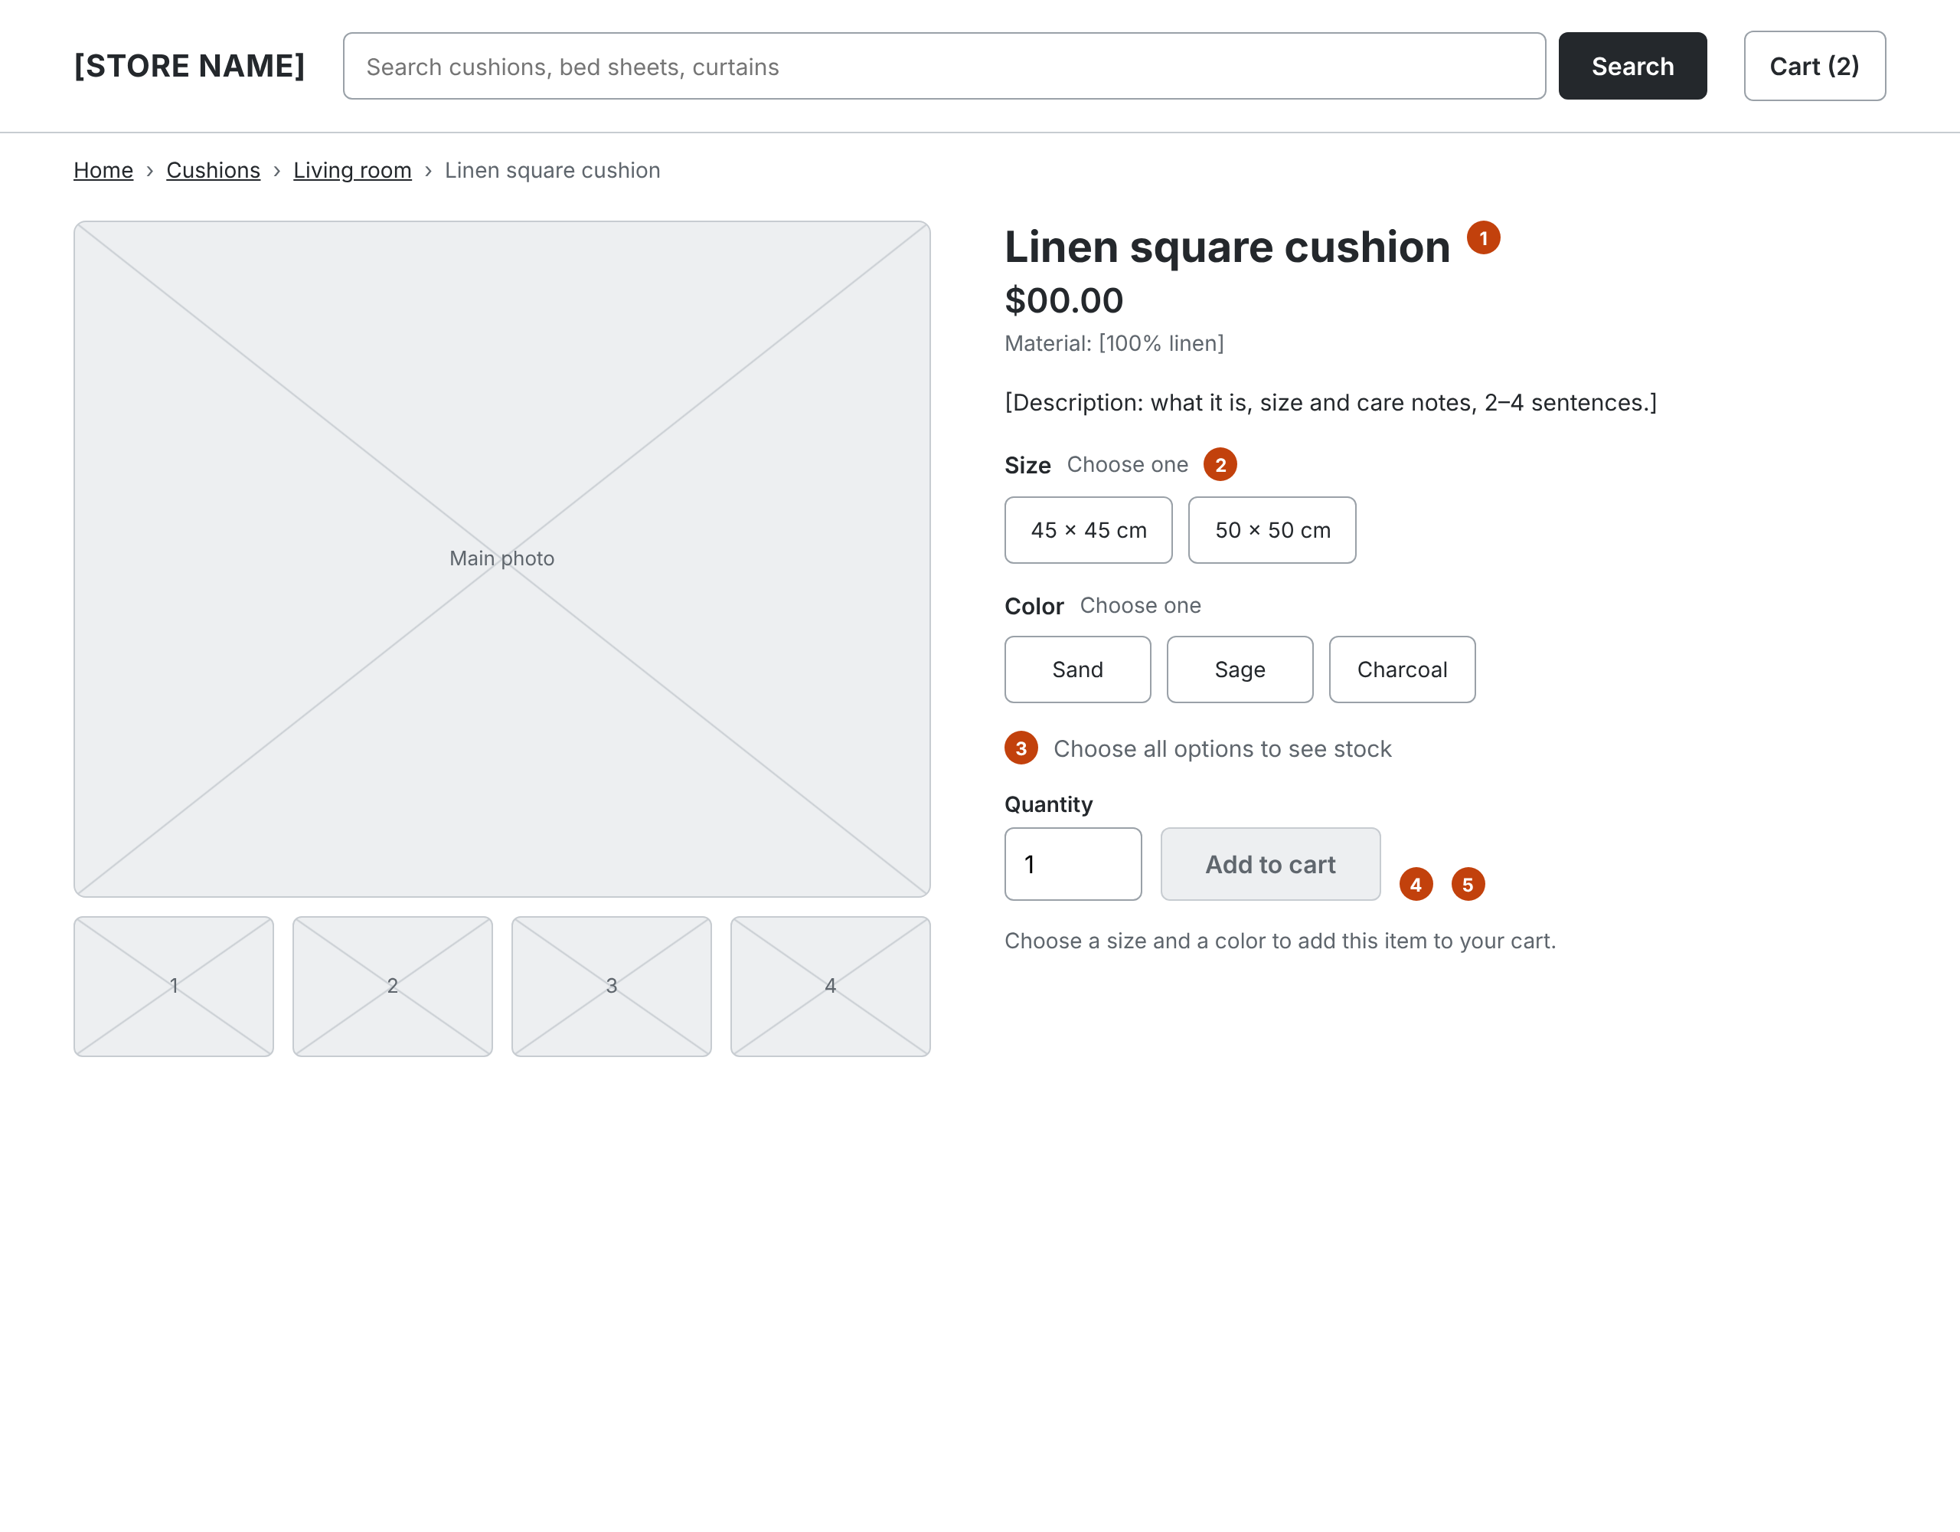
W-04 Product page
Increment 2 · Storefront
Notes:
1 Photos, name, material, price, description (CUS-10).
2 Options come from this product only (RQ4). Values with no stock in any combination are shown but disabled.
3 Stock line shows the stock of the selected combination once every option is chosen (CUS-11, RQ3).
4 Add to cart stays disabled until every option is chosen; helper text says which are missing (CUS-12).
5 Quantity 1 up to the combination's stock (CUS-15).

Slide 10
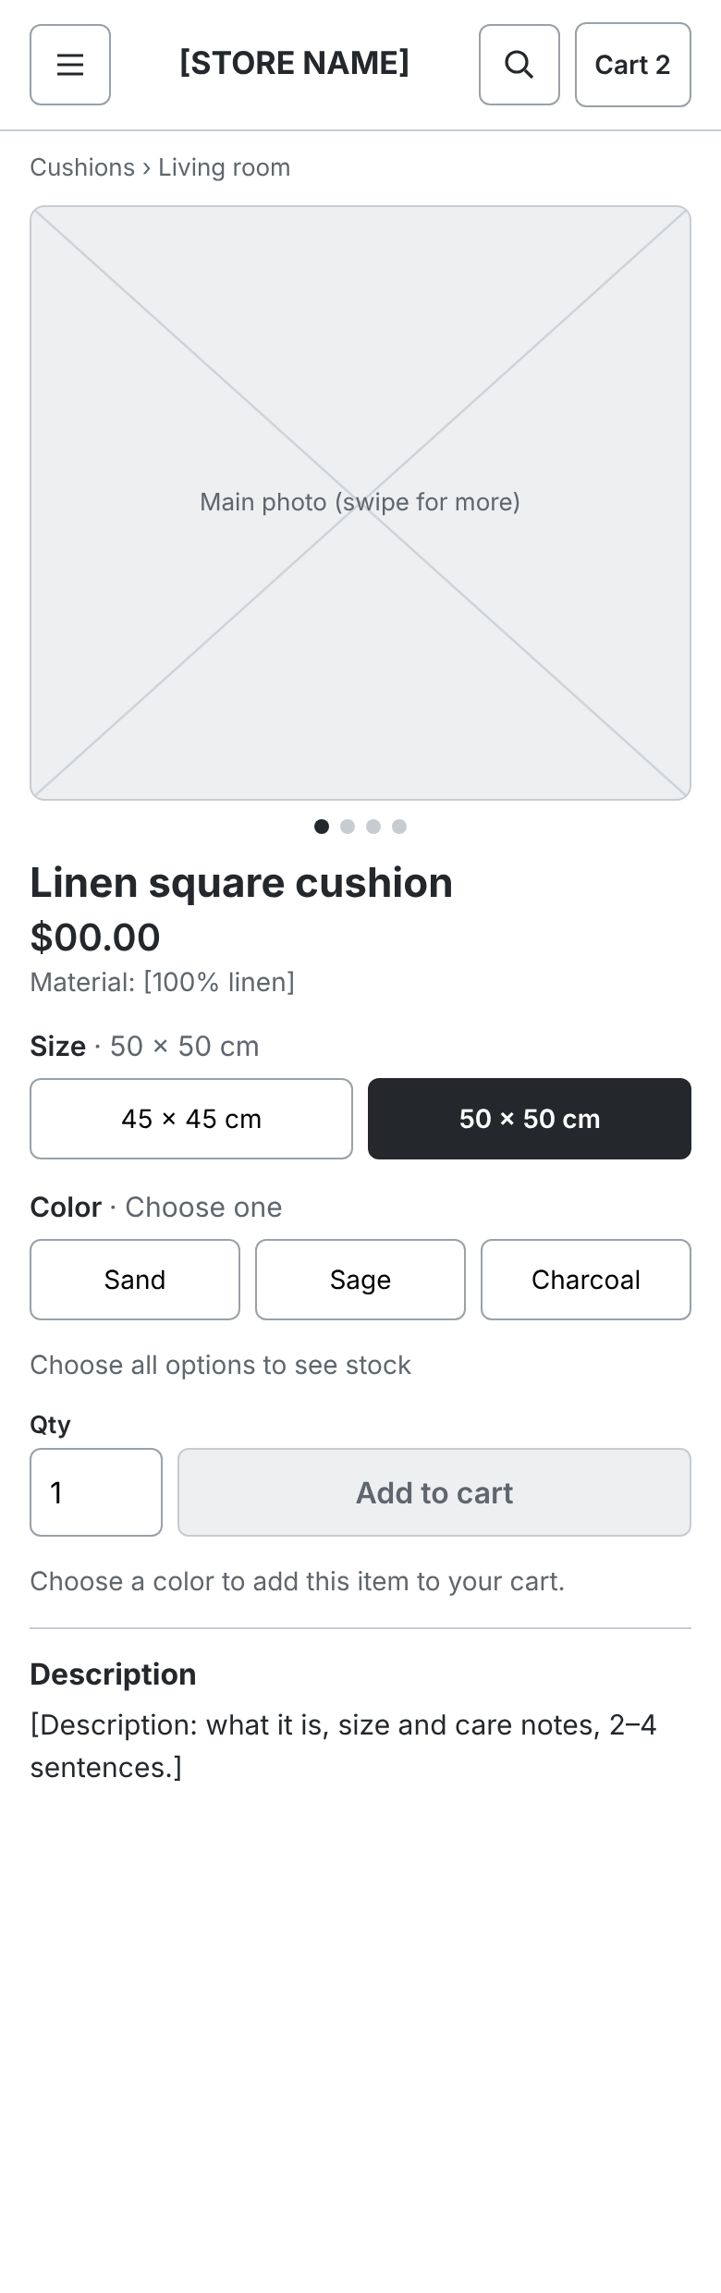
W-05 Product page, phone
Increment 2 · Storefront
Same content as W-04 in one column, 390 px wide (NFR-01). Option buttons are 44 px touch targets. Add to cart sits at the end of the options so it is reached after choosing.
Notes:
Same content as W-04 in one column, 390 px wide (NFR-01). Option buttons are 44 px touch targets. Add to cart sits at the end of the options so it is reached after choosing.

Slide 11
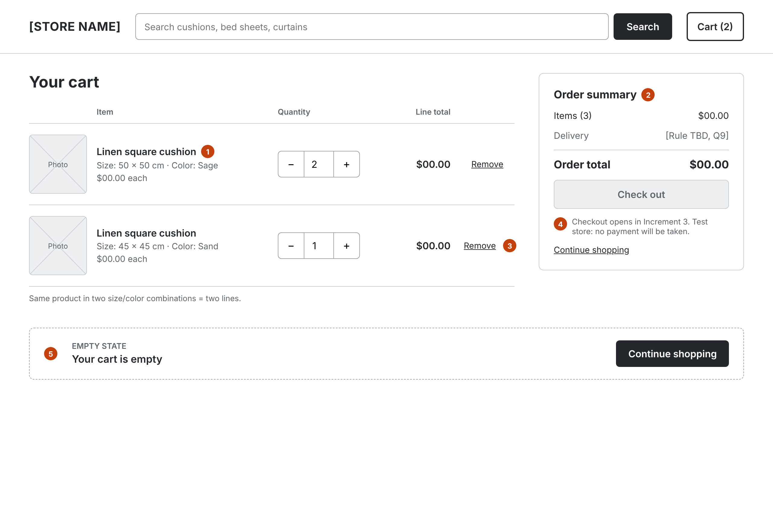
W-06 Cart
Increment 2 · Storefront
Notes:
1 Each line shows chosen options and quantity (CUS-13).
2 Line total = unit price × quantity; order total = sum of lines (CUS-14).
3 Quantity stepper and Remove recalculate at once (CUS-15).
4 Checkout button is visible but disabled until Increment 3, with a short note.
5 Empty cart state: message + Continue shopping.

Slide 12
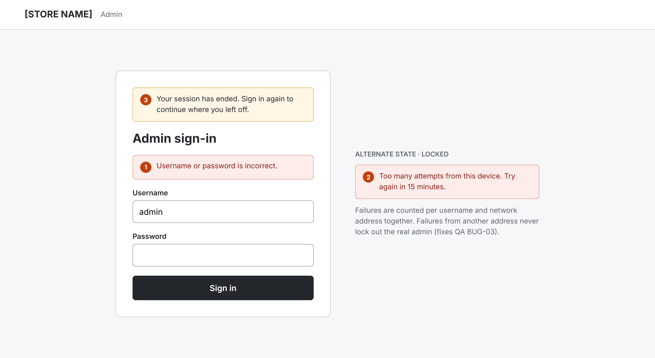
W-07 Admin sign-in
Increment 1 · Admin
Notes:
1 One generic error for wrong username or password (ADM-02).
2 Failed attempts are counted per username + network address, never globally, so others cannot lock out the real admin (QA BUG-03). Message says when to retry.
3 'Your session has ended' banner when an expired session is sent back here (QA OBS-09).

Slide 13
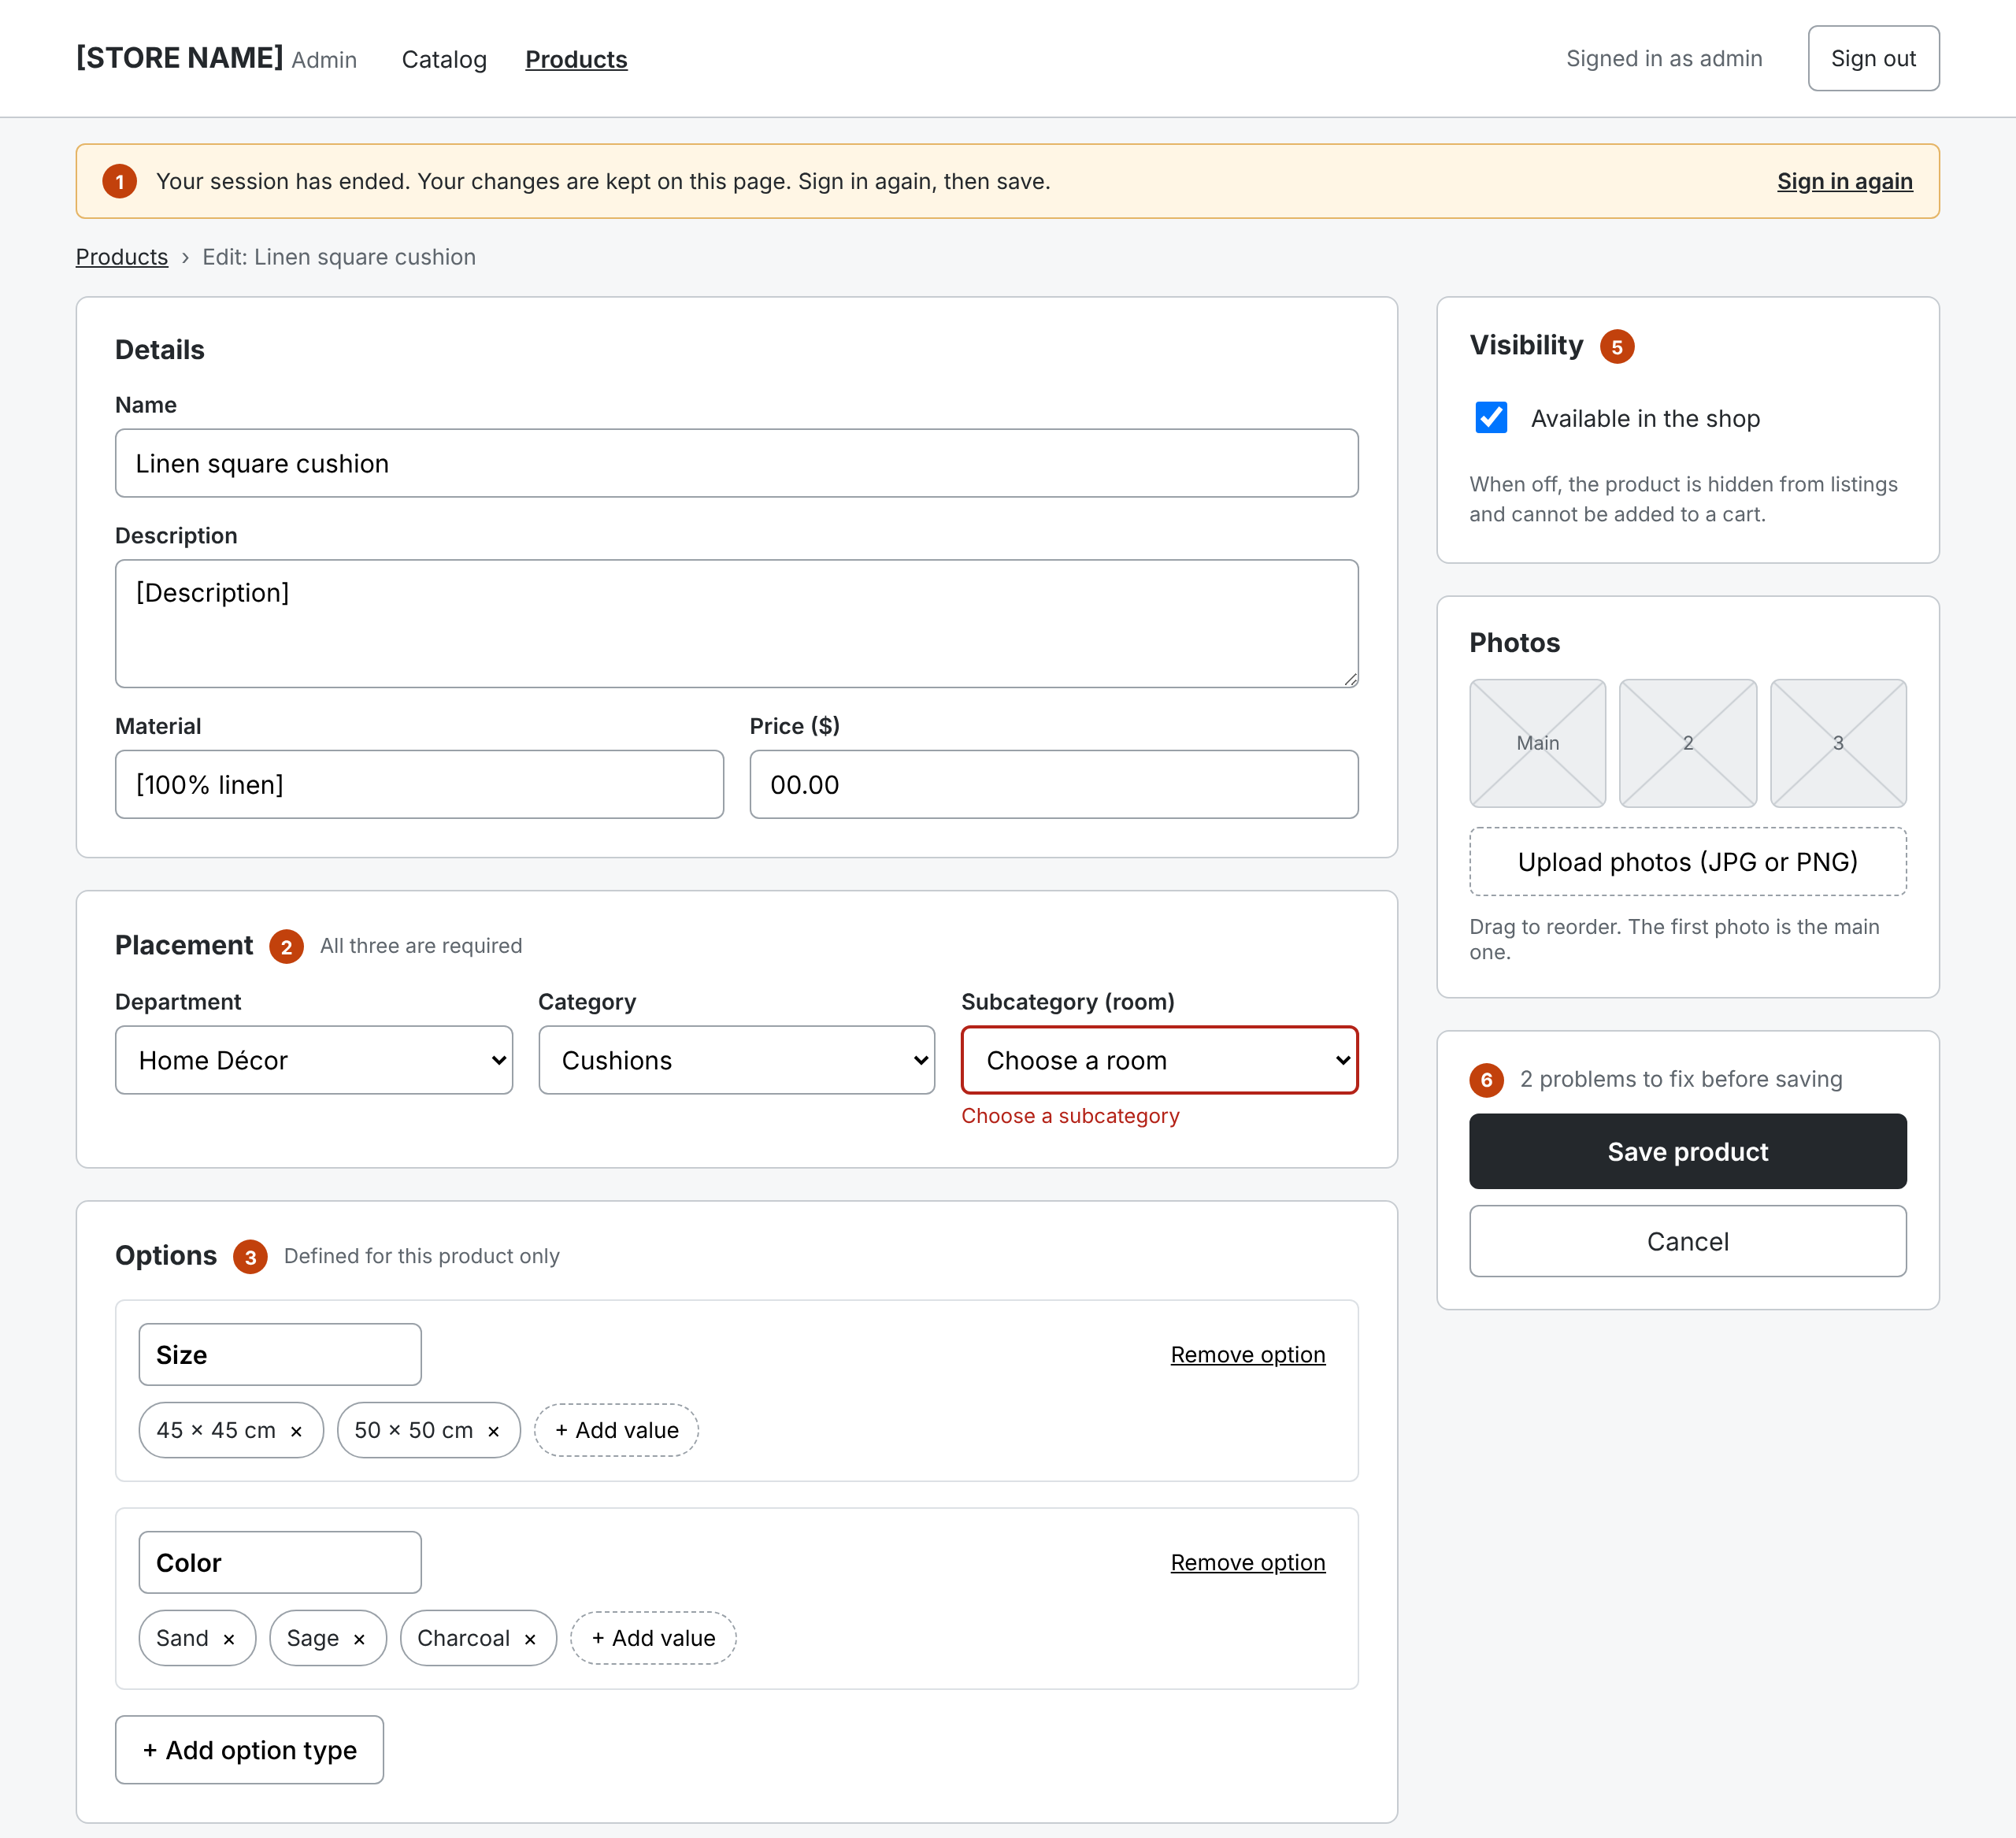
W-08 Admin product editor (1 of 2)
Increment 1 · Admin
Notes:
1 Session expiry: banner + Sign in again, input kept in the form (QA OBS-09).
2 Placement: three linked lists; each shows only children of the level above (ADM-08).
3 Option types per product; values unique within a type (RQ4).
4 Stock grid: one row per combination, built by the system, no duplicates, no cross-product values (QA BUG-01, RQ3).
5 Available switch: off hides the product from the shop (ADM-10, QA BUG-02).
6 Save validates on the server; errors show beside each field.

Slide 14
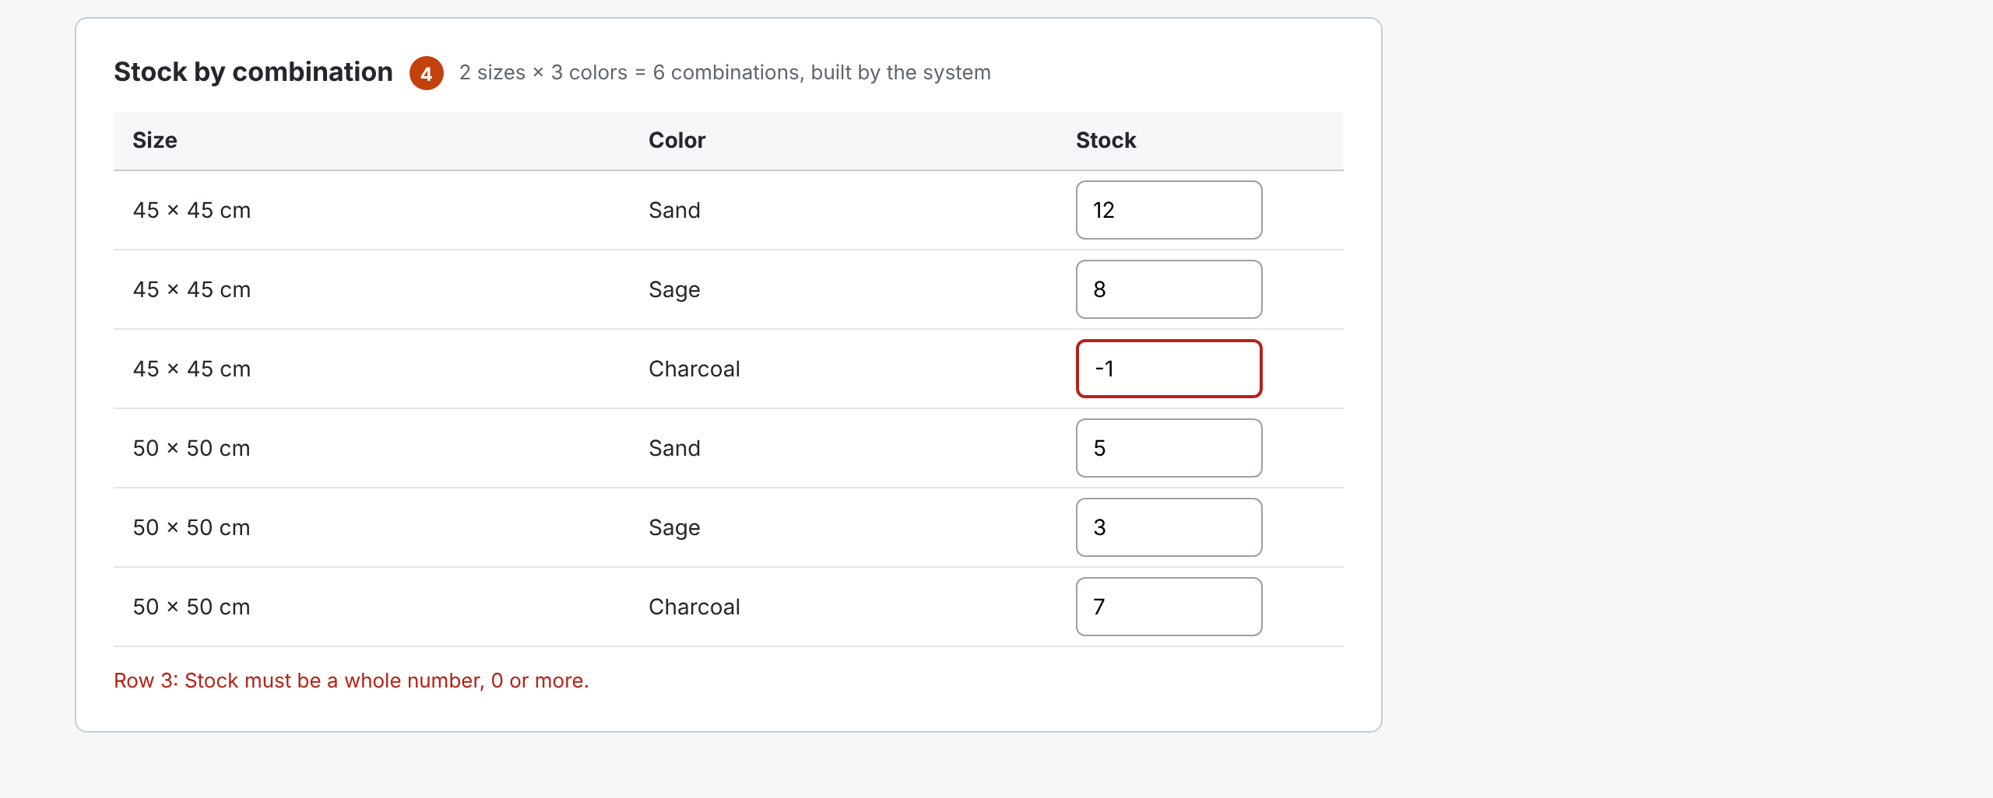
W-08 Admin product editor (2 of 2)
Increment 1 · Admin
Notes:
1 Session expiry: banner + Sign in again, input kept in the form (QA OBS-09).
2 Placement: three linked lists; each shows only children of the level above (ADM-08).
3 Option types per product; values unique within a type (RQ4).
4 Stock grid: one row per combination, built by the system, no duplicates, no cross-product values (QA BUG-01, RQ3).
5 Available switch: off hides the product from the shop (ADM-10, QA BUG-02).
6 Save validates on the server; errors show beside each field.

